Slide 1
Hand Written Digit Recognition using Convolution Neural Network
Submitted by :
Priyanshu Gupta (1802911033)

Slide 2
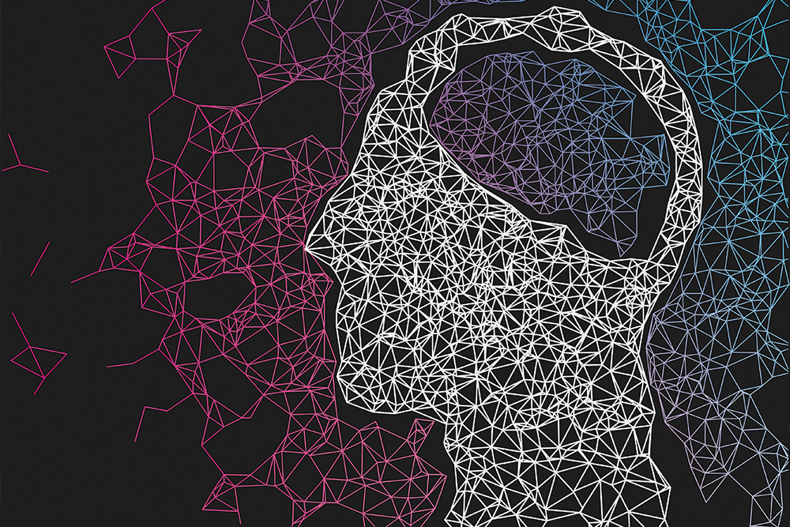
Contents
Abstract
Introduction
MNIST Dataset
Objective
Flow Process
Results
Conclusion
References

Slide 3
ABSTRACT
The field of machine learning is a rapidly developing one. Recent developments in the field of image processing and machine learning has led to efficient extraction of features from images of peoples’ faces.
Recognizing handwritten digits from images isn’t easy. It involves the difficulty of visual pattern recognition which becomes very apparent when an attempt is made to write a computer program to recognize digits. The goal of our work will be to create a model that will be able to recognize and determine the handwritten digits from its image.
We aim to complete this by using the concepts of Convolution Neural Network.

Slide 4
INTRODUCTION
There are many fields concern with numbers, for example, checks in banks or recognizing numbers in car plates, the subject of digit recognition appears.
In other words, to let the computer understand the Arabic numbers that is written manually by users and views them according to the computer process. Here, we present a way to recognize isolated Arabic digits exist in different applications.

Slide 5
MNIST DATASET
MNIST Dataset stands for Modified National Institute of Standards and Technology Dataset.
It has 70,000 samples of hand written images.
Each image has small square of 28×28 pixel.
All the images are in grayscale.
Each image has hand written single digits between 0 and 9.
Each pixel has value between [0-255] where 0 represents black and 255 represents white.

Slide 6
OBJECTIVE
The main objective of our project is to recognize hand written digits exist in different application.
For example, different users have their own handwriting styles where the main challenge falls to let computer system understand these different handwriting styles and recognize them as standard writing.

Slide 7
FLOW PROCESS
Juypter Notebook is created.
Imported libraries like Numpy, Keras, Matplotlib etc.
Load Mnist dataset in train & test variables.
Visualize randam images using Matplotlib.
Reshaping images in required format.
Normalized dataset using One hot encoding.
Building the CNN model with layers such as Conv2D, MaxPooling2D, Dropout, Flatten and Dense to attain maximum accuracy.
Compiled the model with loss = categorical_crossentropy, optimizer = adam, and metrics attributes.
Fitted the model with epochs = 10 so that model can train 10 times on batch_size = 200 on entire dataset.
In Last, checking the accuracy of model.

Slide 8
RESULTS
We get increasing accuracy in every epochs and decreasing loss in every epochs.
Finally, We clearly Recognize hand written digits with the accuracy of 98.88 %.

Slide 9
CONCLUSION
We can conclude that we reached the computer to the human’s brain by the importance use of isolated digits recognition for different applications.
This recognition starts with acquiring the image to be preprocessed throw a number of steps.
As an important point, classification and recognition have to be done to gain a numeral text.
In a final conclusion, convolutional neural network seems to be better than other techniques used for recognition.

Slide 10
REFERENCES
Google
Some channels of Youtube like CodeWithHarry etc
Blogs on Convolutional Neural Network
TensorFlow website

Slide 11
THANK YOU

